Slide 1
Group #1
IaaS, PaaS, SaaS
A brief guide to cloud computing service models

Slide 2
Three types of Cloud Services
SaaS Users of SaaS rather than fully buy the license of various software hire the software at regular intervals and use it through an Internet browser. The variety of software Provided by SaaS is very broad. In this service model, the cloud-based applications are offered to the customer as a service on request. PaaS provides computers platforms for users of cloud computing. It is also the link between the other two services provided by cloud computing; SaaS and IaaS. Some of the facilities that PaaS provides include hosting, implementation, test and application development, and application design IaaS IaaS is the third type of computing across the cloud. Just like PaaS and SaaS, different software and hardware devices deliver on a cloud platform, while IaaS provides a virtualized platform. The process of hardware virtualization shows the users only the abstract computing platform instead of the physical functions.

Slide 3
Real-life situations per service
IaaS
Home project that requires heavy computation
Image processing with raspberry pi (gcp)
PaaS
Cloud Gaming Service
Runs the games on the cloud. Streamed back to user
SaaS
This assignment where we all need to use one software together(Slide/Doc)
Google hosts these software on their platform

Slide 4
Why these services
IaaS
For and example like Rasberry PI a microprocessor and operating system. IaaS saves the business having to buy the server and expense equipment. Instead you can just rent the space.
PaaS
Saves the user having to run the game on their computer and take up memory.
Software is separate from platform. All servers, storage, and networking can be managed by the enterprise or a third-party provider while the developers can maintain management of the applications.
SaaS
Google workspace is hosted by google on their platform.
managed by a third-party vendor, to its users. It means they do not require any downloads or installations on the client side.

Slide 5
Which type of cloud (private, public, hybrid) is the best for each situation.
IaaS - For Home project that requires heavy computation, Private Cloud is the best cloud type.
PaaS - For Cloud Gaming Service, Private Cloud would be the best.
SaaS - For Google Slides/docs, Public Cloud would be the best because everyone with the link can access and edit the docs.

Slide 6
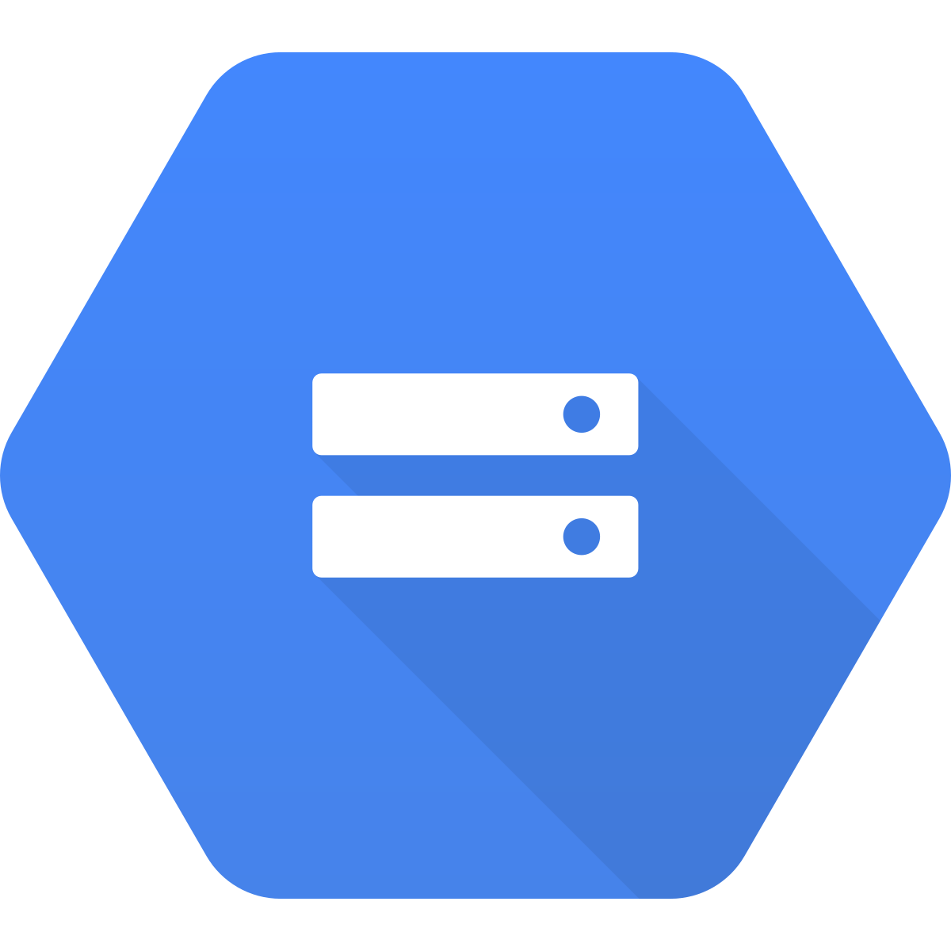
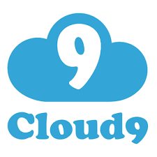

Identify specific services
IaaS
Google Cloud Storage - Private access
PaaS
AWS Cloud9 - Hybrid access
SaaS
Github - Public Access

